Slide 1
HPC and Davis lab GitHub usage
Dharmesh Bhuva & Soroor Hediyeh-zadeh

Slide 2
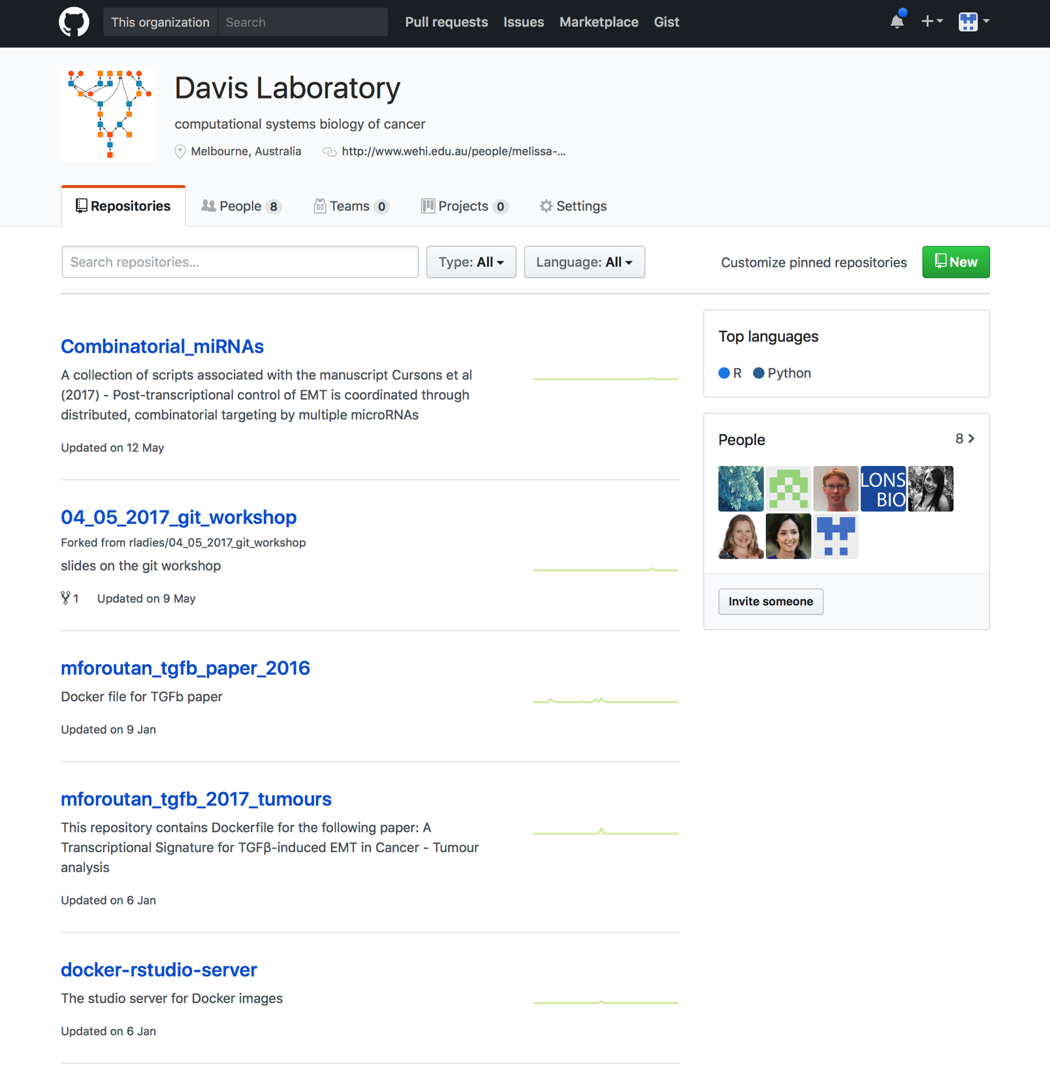
Davis Lab GitHub repository
An open-source repository for ready-to-publish code and software prepared by members and students of the lab
Learning resources such as Git tutorials, Bioinformatics/R courses
https://github.com/DavisLaboratory

Slide 3

Introducing Milton…

Slide 4
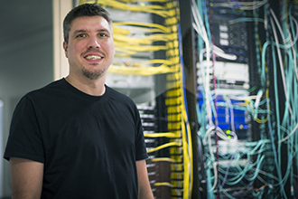
The (brain behind) Research Cloud Computing…

Slide 5

HPC Resources
User guide on Catalyst
Milton Seminars sign up to mailing list http://unix01.wehi.edu.au/mailman/listinfo/hpc
Milton on Slack
WEHI Research Computing on GitHub
Github.com/WEHI-ResearchComputing/milton-contrib
AND

Slide 6
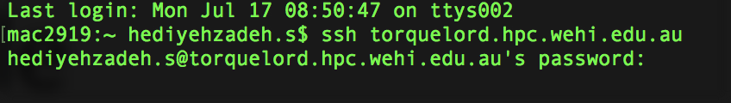
Getting started with HPC
ssh, public key, private key
Please note this step assumes that you’ve already set-up the connection to HPC, please refer to user guide on Catalyst

Slide 7
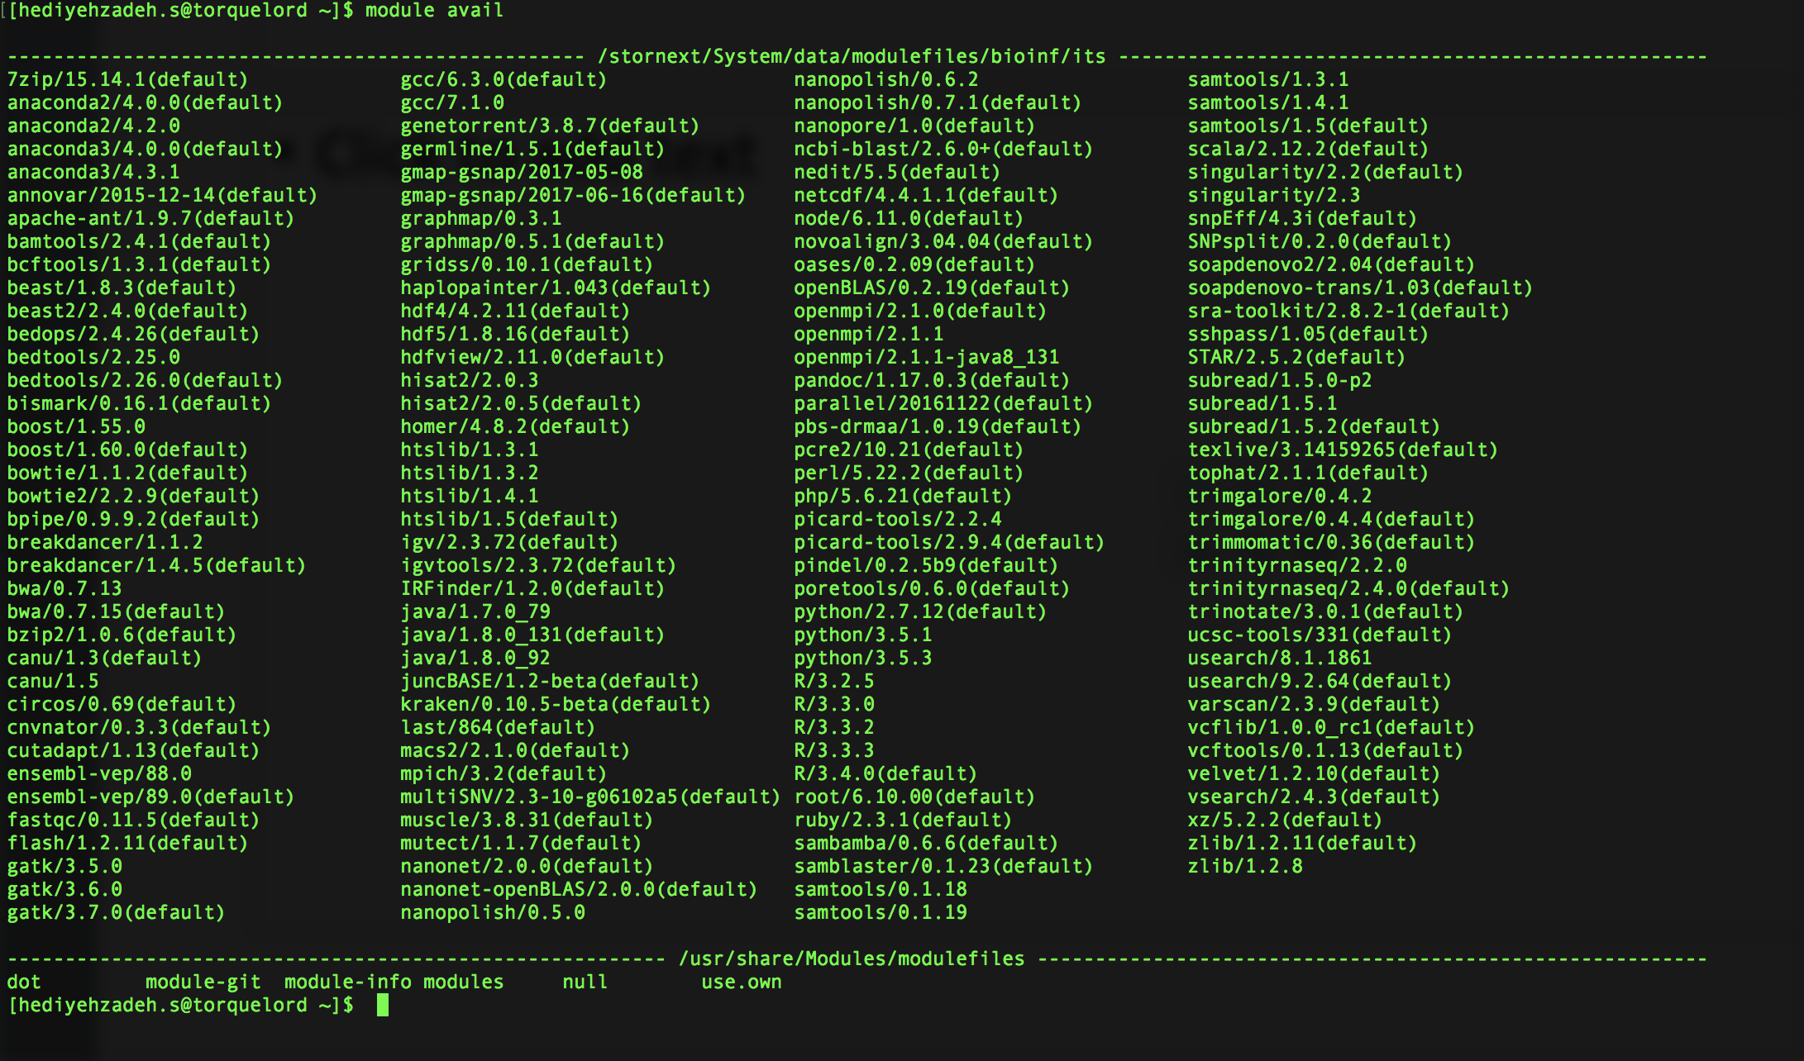
The modules

Slide 8
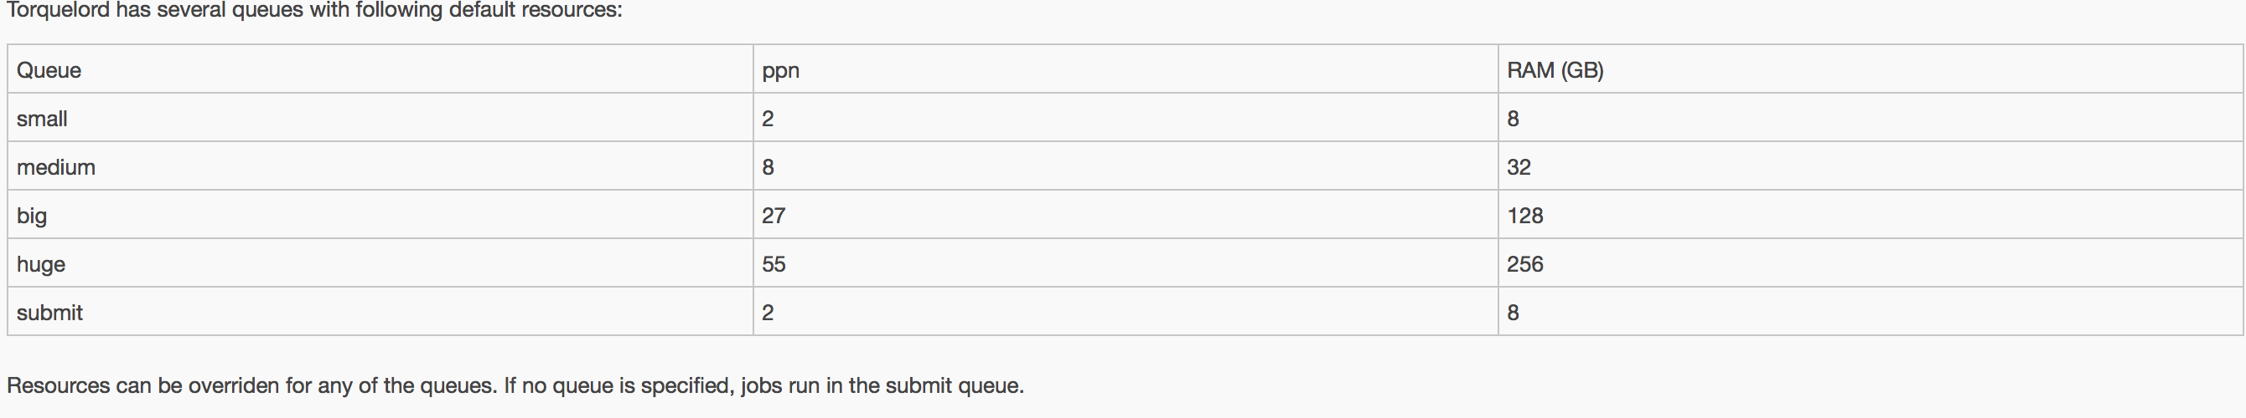
Torquelord- the queuing system
Milton = HPC = torquelord
The purpose: To run multiple, independent jobs concurrently
Job processing is currently based on first-in, first-out strategy, but this very much depends on resources that were requested I recommend you attend Milton lunch seminars to learn more about the queuing system
Default Queue vs Personal Queues

Slide 9
Submitting jobs to torquelord: a two-step process
Need 2 levels of scripts to submit jobs to torquelord
The submission script and the actual code

Slide 10
Example actual code - Kraken
kraken_seqClassify.sh ( I keep this on davis_lab)
#!/bin/bash
module load kraken
kraken_db=/wehisan/general/academic/lab_davis/ctx/kraken/db
OUT_DIR=/wehisan/general/academic/lab_davis/ezh2
filename=`basename $1| sed "s/_R1_001.bam//"`
…..
# kraken
kraken --db ${kraken_db} --threads 6 --fasta-input --quick --min-hits 10 --output $OUT_DIR/kraken_results/${filename}_sequences.txt --check-names $OUT_DIR/${filename}.fasta
kraken-translate --db ${kraken_db} $OUT_DIR/kraken_results/${filename}_sequences.txt > $DIR_OUT/kraken_results/${filename}_labels.txt
Don’t forget to do chmod +x script.sh to make your script executable

Slide 11
Submission script for Kraken jobs
kraken_submit.sh ( I keep this on my torquelord home directory)
#!/bin/bash
DIRPATH=/wehisan/general/academic/lab_davis/ezh2
BAM_PATH=${DIRPATH}/BAM_files
BAM_files=`ls ${BAM_PATH}/*bam | grep -v markdup`
SUBMISSION_SCRIPTS=./submission_scripts
for bam in $BAM_files
do
SCRIPT_NAME=`basename $bam | sed "s/_R1_001.bam//"`
echo ${DIRPATH}/kraken_seqClassify.sh $bam > ${SUBMISSION_SCRIPTS}/kraken_${SCRIPT_NAME}.sh
chmod +x ${SUBMISSION_SCRIPTS}/kraken_${SCRIPT_NAME}.sh
qsub -q big ${SUBMISSION_SCRIPTS}/kraken_${SCRIPT_NAME}.sh
done

Slide 12
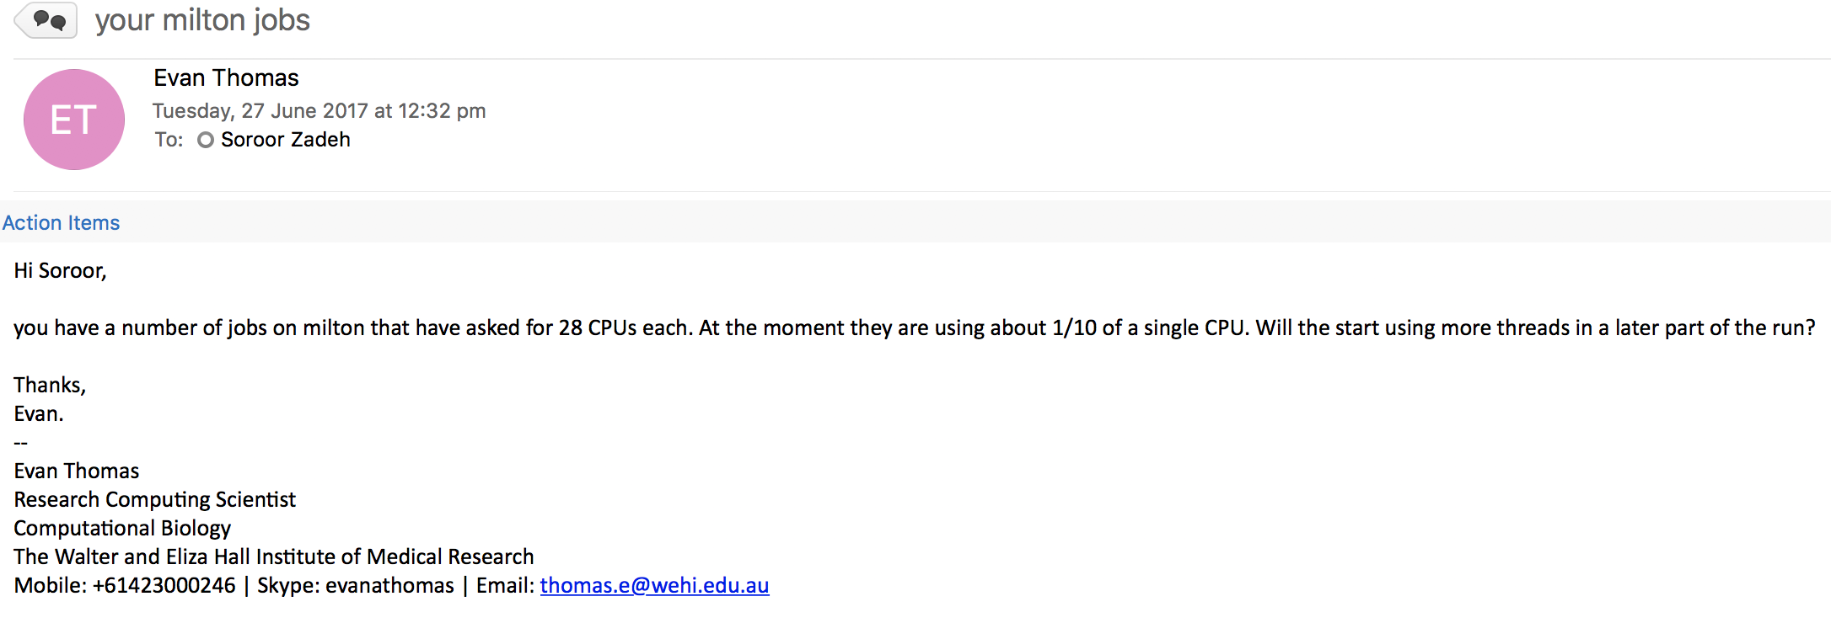
Where things can go wrong – a (common??) mistake

Slide 13
Quick review of the HPC
I promise its quick!

Slide 14
1. ssh into head node
2. qsub to submit job
Head node (Fat node)
26 nodes
3. Job dispatch
Dharmesh
Node (56 procs)
Node (56 procs)
Node (56 procs)
Soroor
Node (56 procs)
Node (56 procs)
Node (56 procs)
Skynet (Shhh…)
stornext
HPCScratch
Node (56 procs)
Node (56 procs)
Node (56 procs)
wehisan (your normal files)
4.1. VERY FAST Read/write operations
MILTON
4.2. SLOWER Read/write operations
Notes:
Clarify the different storages

Slide 15
Bootstrapping computations

Slide 16
Bootstrapping computations with R
Involves a function that needs to be evaluated numerous times with different parameters.
It is important that all evaluations are independent of each other.
Done by creating a socket cluster
Notes:
Example: Calculate signature scores across 1000s of samples (same process for each sample)

Slide 17
Package combination
Required packages:
parallel
doParallel – parallel back-ends (can use ‘snow’)
foreach – for loop-like implementation of parallelization
Other packages:
doRNG (Reproducible random numbers)
Iterators

Slide 18
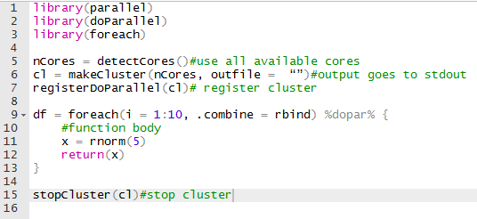
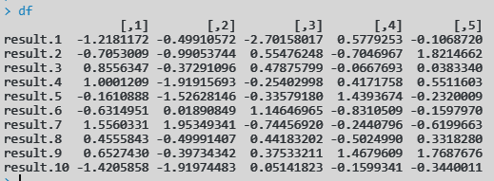
Code
NOTE: clusters here are an interface to the physical cluster

Slide 19
How do Socket clusters work?
With 20 cores, 20 processes are created
Copies of ALL variables in the current environment are dispatched to each process
Expressions in the foreach loop are then executed by each process
Process 1
Process 2
Process n
Data matrix
Data matrix
Data matrix

Slide 20

Memory estimates are important!
Data matrix and all other variables may be 3Gb
With 2Gb results, this would be say 5Gb
Request of huge queue made (55 procs, 256 Gb mem)
Memory requirement 275 Gb
PROCESS CRASHES AND HOURS WASTED

Slide 21
Option 1: Default queues with modified qsub
Format
qsub –q submit –l nodes=1:ppn=55,mem=275gb job.sh
qsub –q submit –l nodes=2:ppn=50,mem=275gb job.sh
This is always a submission to the default queue (small)
The first command will allocate 55 processors and 520Gb of memory
The second will allocate 100 processors and 520Gb of memory across 2 nodes (Max per node is 55+1 processors)

Slide 22
Option 2: OR uses iterators!
Processing 1 column of the matrix per function call?
Why copy the entire matrix, just copy iterators (pointer to the column)
iterators package in R can be used to do so
i_1
i_2
i_n
Process 1
Process 2
Process n
i_1
i_2
i_n
Data matrix

Slide 23
Option 3: Exclude non-relevant variables
Since the entire R environment is copied when using socket clusters, exclude variables not used in the function.
In the foreach context this is done using the .noexport = c(list_of_vars)

Slide 24
Similar concepts in Python
Concepts in R apply to python as well
Creating the cluster, dispatching jobs and combining results is a bit involving.
dispy library used to create clusters and dispatch jobs to it

Slide 25
Summary
Bootstrap parallelization is easy!
Memory estimates should be made and resource requests should be done accordingly
Soon we may need to have time estimates as well. A good way to estimate is to generate a curve with different problem sizes and extrapolate. Contact Dharmesh for more on this.
Really soon as Liam mentioned!

Slide 26
Estimation
For the large problem (e.g. 10000 data points), scale it down to a very small chunk (e.g. 10 data points)
Estimate resources for chunk (time and memory)
(n=5?) Repeat for varying problem sizes (10, 100, 1000, 1500, 2000)
Plot curve of resource usage and extrapolate to n=10000
I usually add 15-20% on all estimates. 5% if I am VERY confident with my estimates (I’m a terrible estimator ☹)
Estimate
Resource (e.g. time)
Problem size

Slide 27
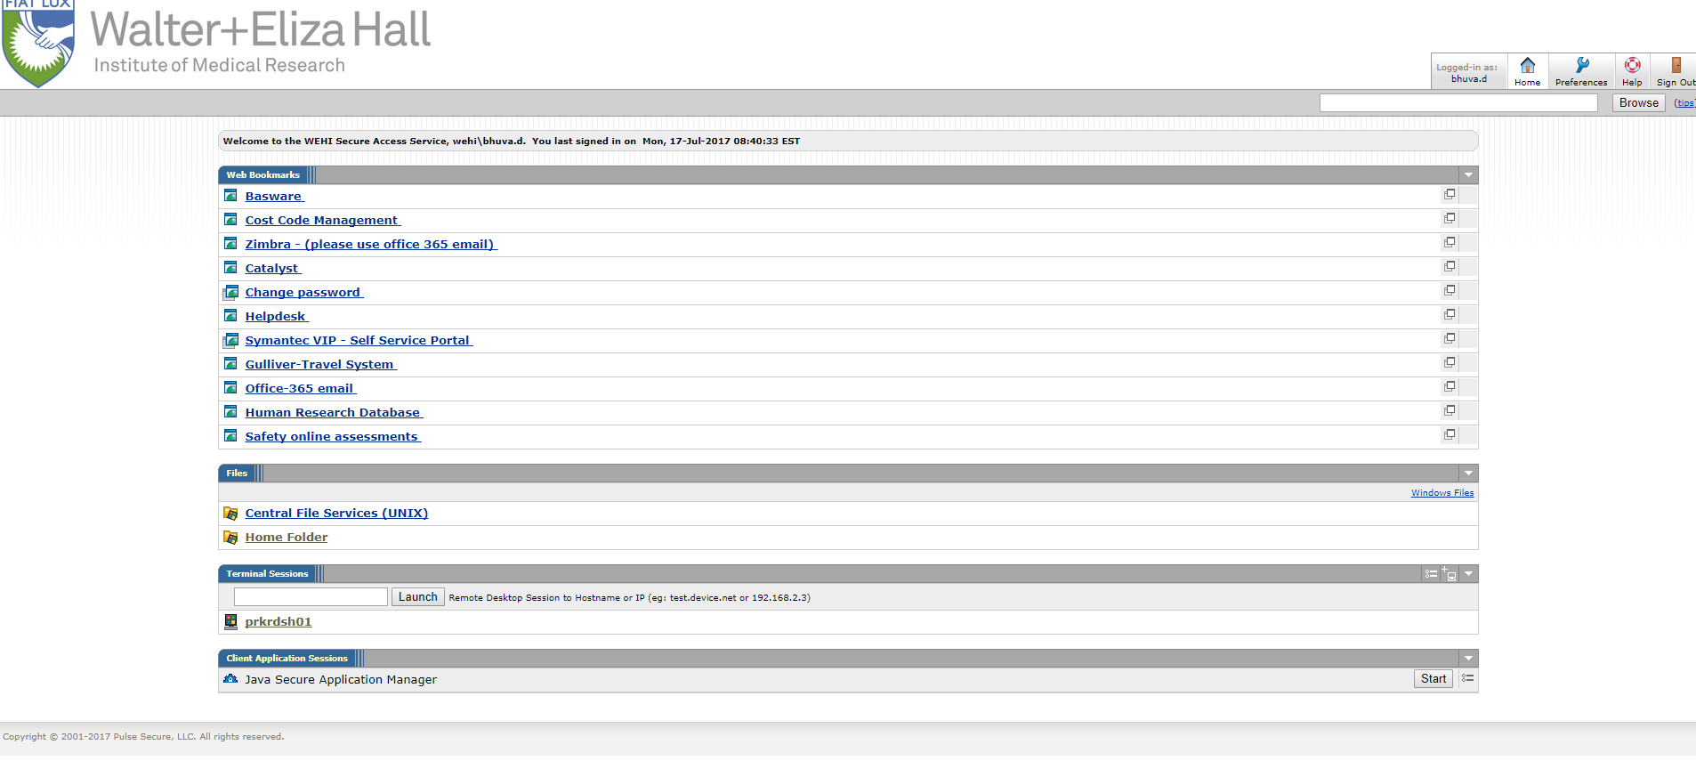
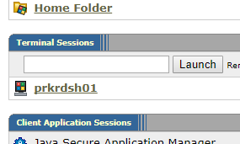
Quick note: RDP using prkdsh01

Slide 28
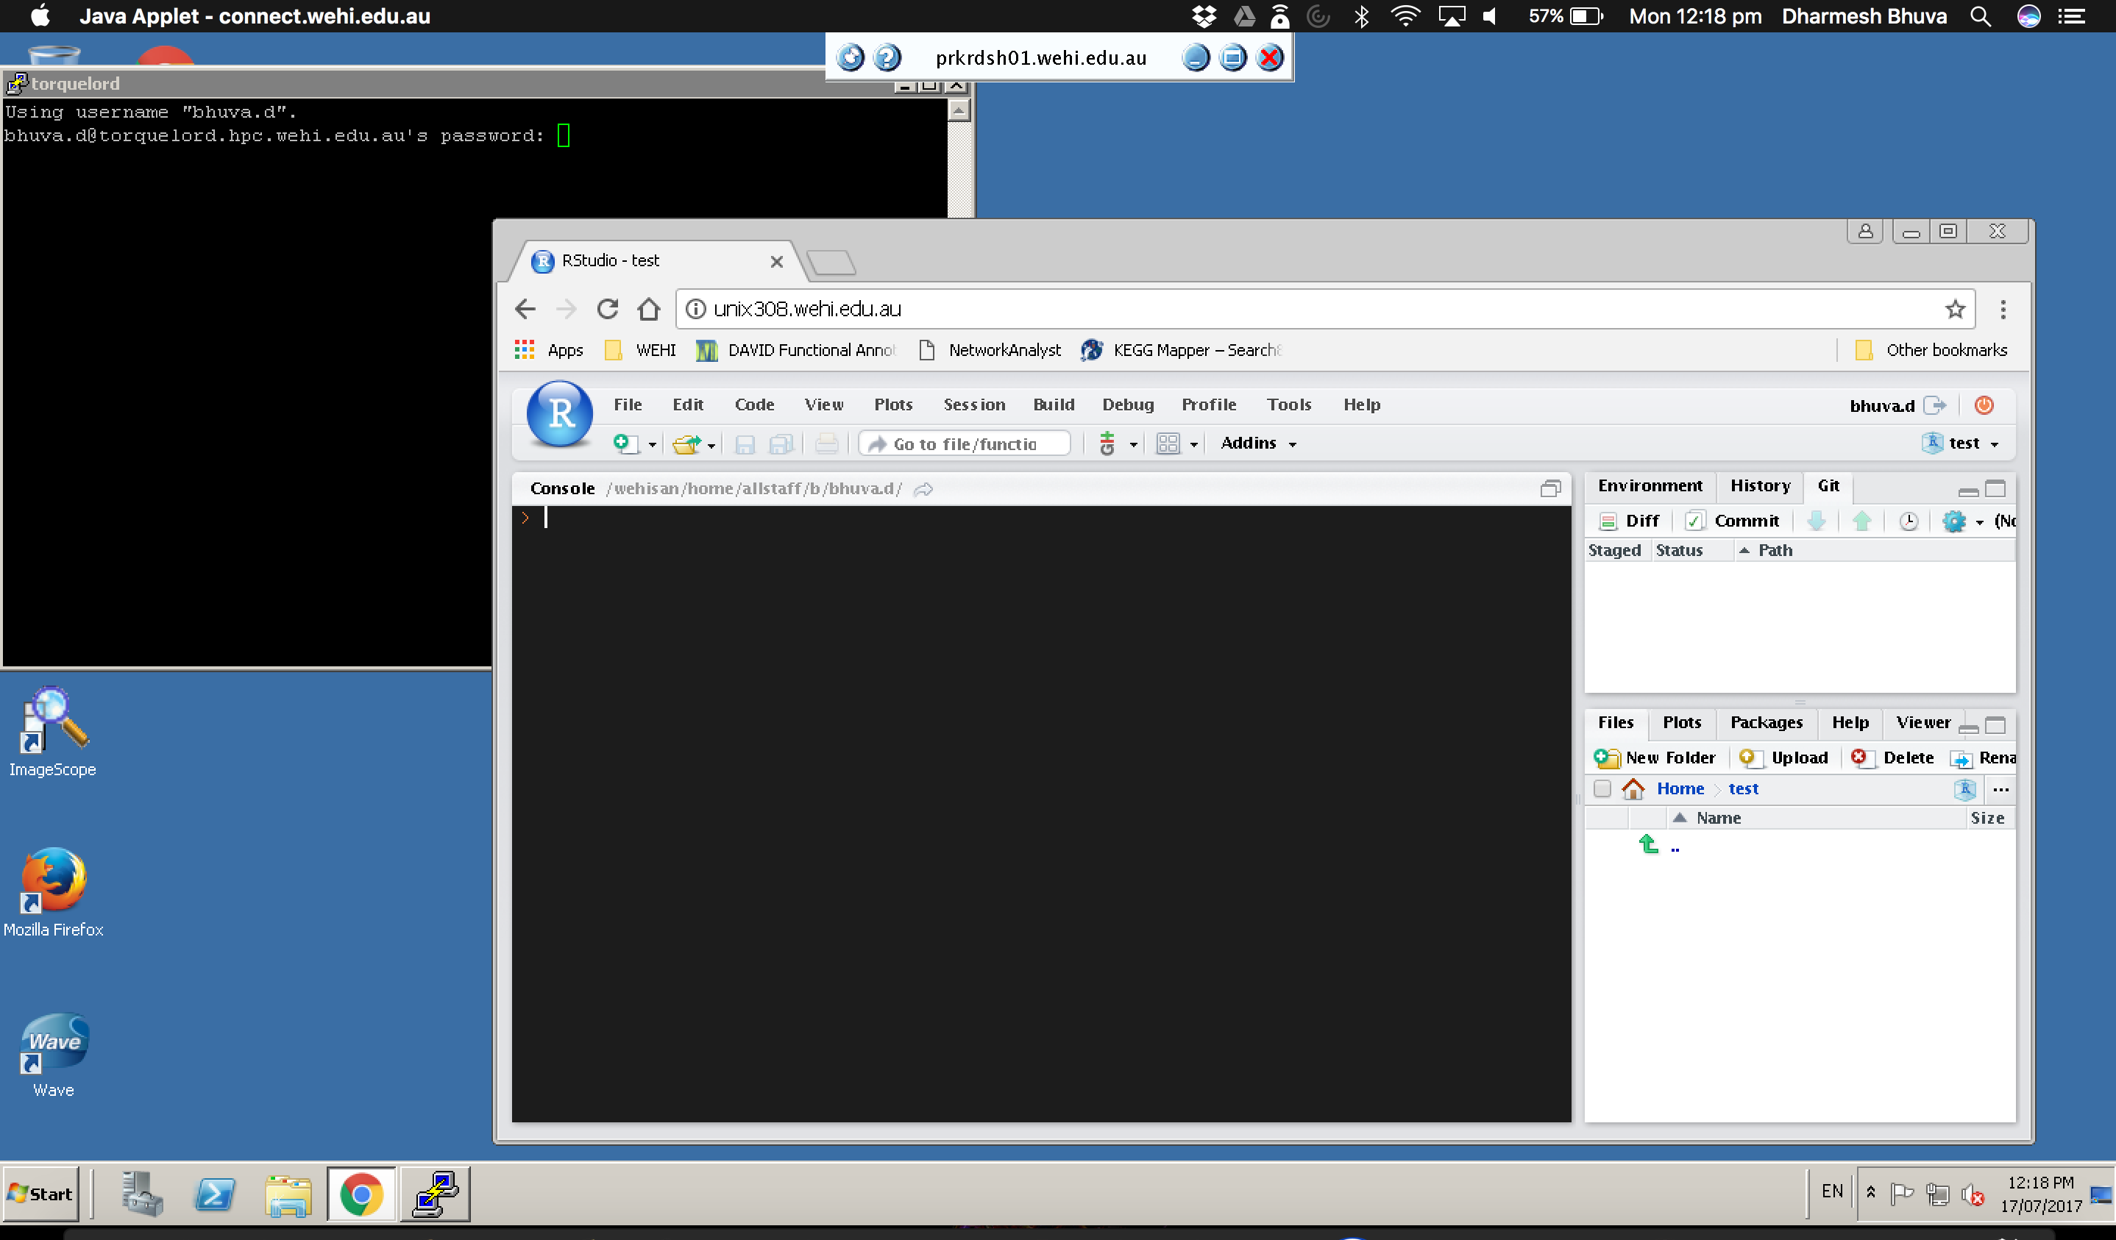

Slide 29
prkdsh01
Works on safari and firefox only
Needs access to Java
Java security settings need to be modified to allow connect.wehi.edu.au
To get access to prkdsh01, ask the IT guys to give access
Good for urgent access to WEHI resources (e.g monitoring job progress off-site)

Slide 31
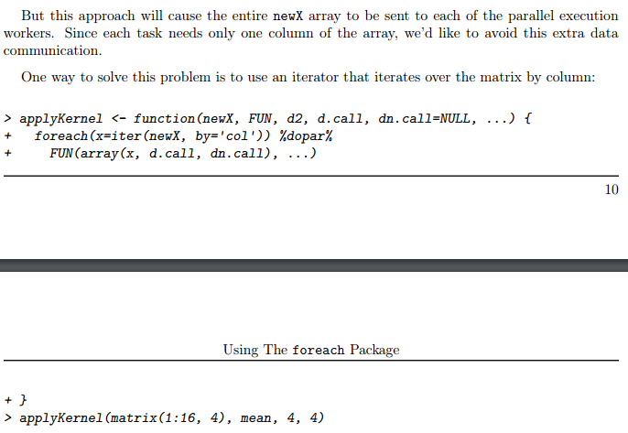
Iterators example

